Slide 1
PubMed Data Analysis
Daniel Auerbach
POCs: Rene Ranzinger, Sena Arpinar
Volunteership Symposium, July 30th, 2026

Slide 2


About me
Virginia Tech
  Major: BS in Computer Science
  Minor: Creative Writing
Starting GWU this Fall
  MS in Bioinformatics and Molecular Biochemistry
Research Interests
  Not quite sure yet…
General Interests
  Movies, reading, my two cats, cooking, volleyball, Ultimate Frisbee, being outdoors

Slide 3
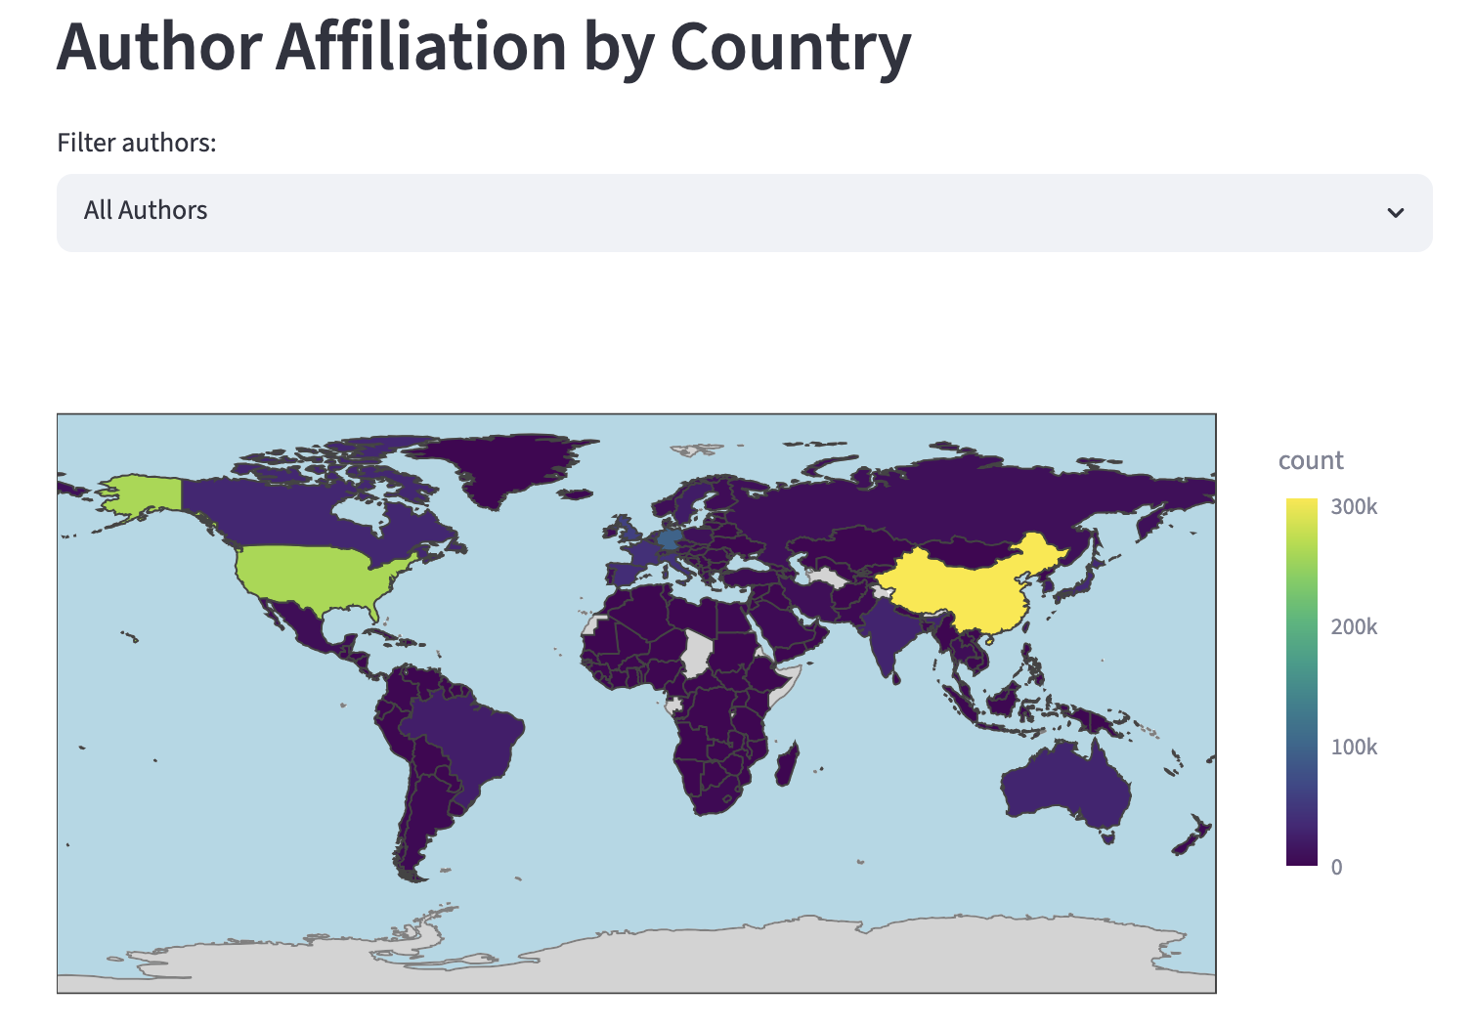
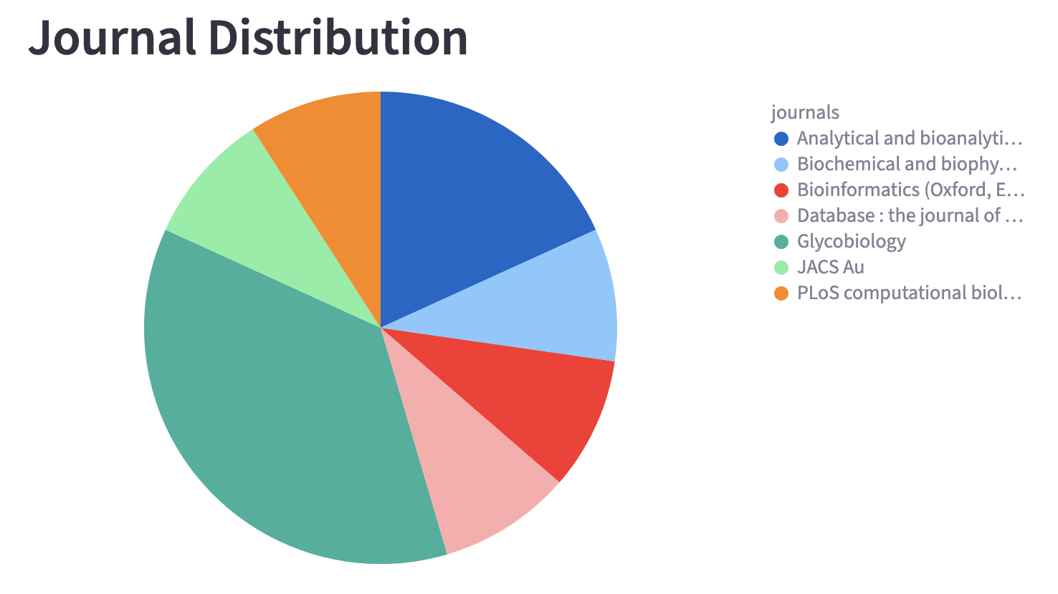
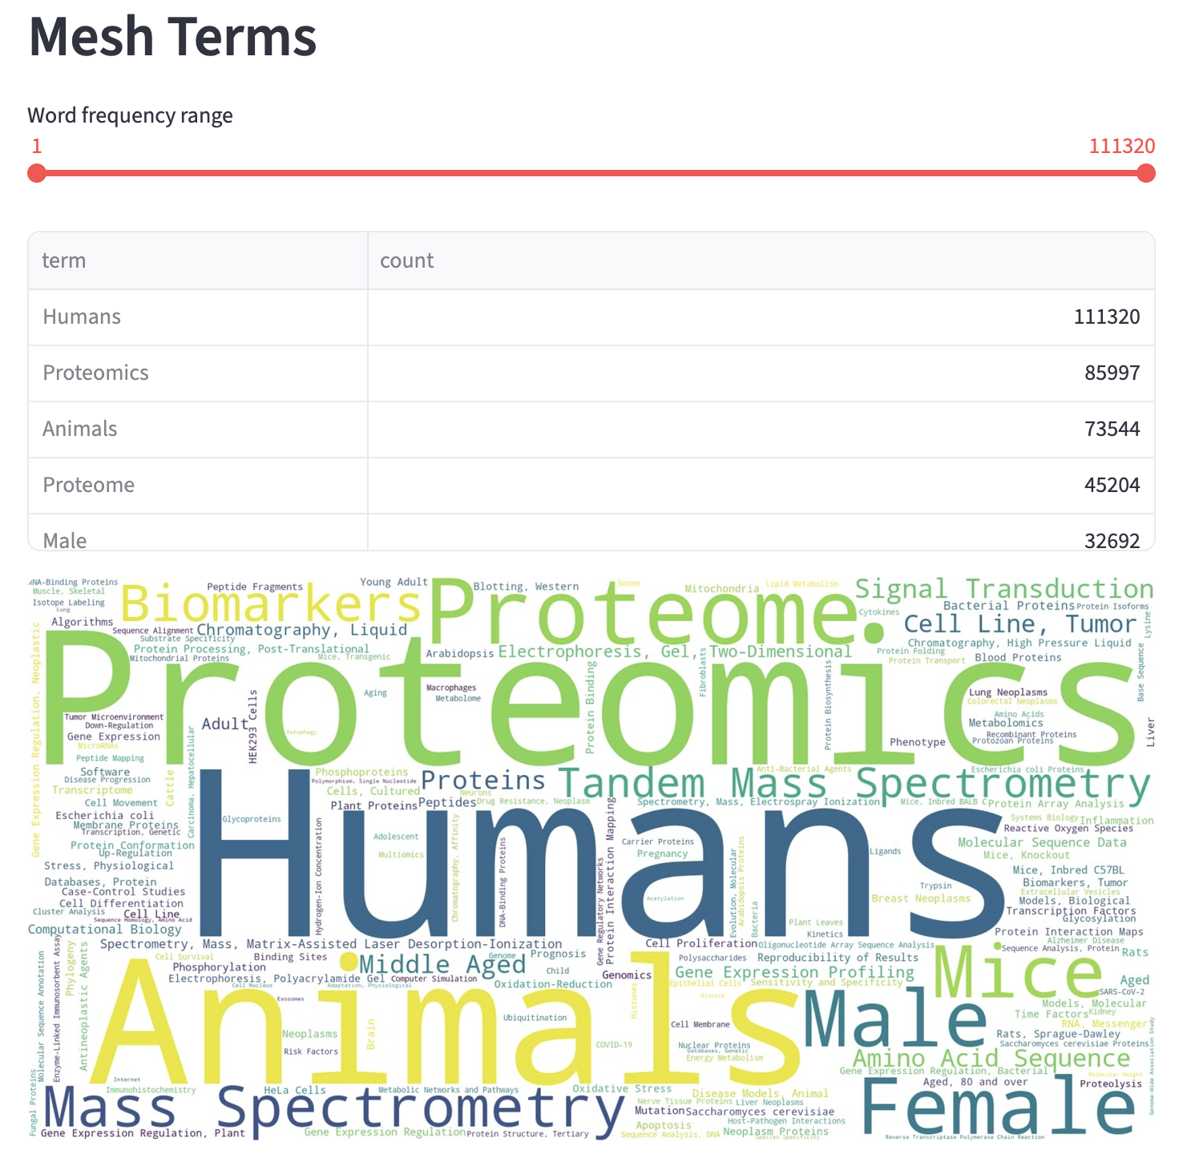
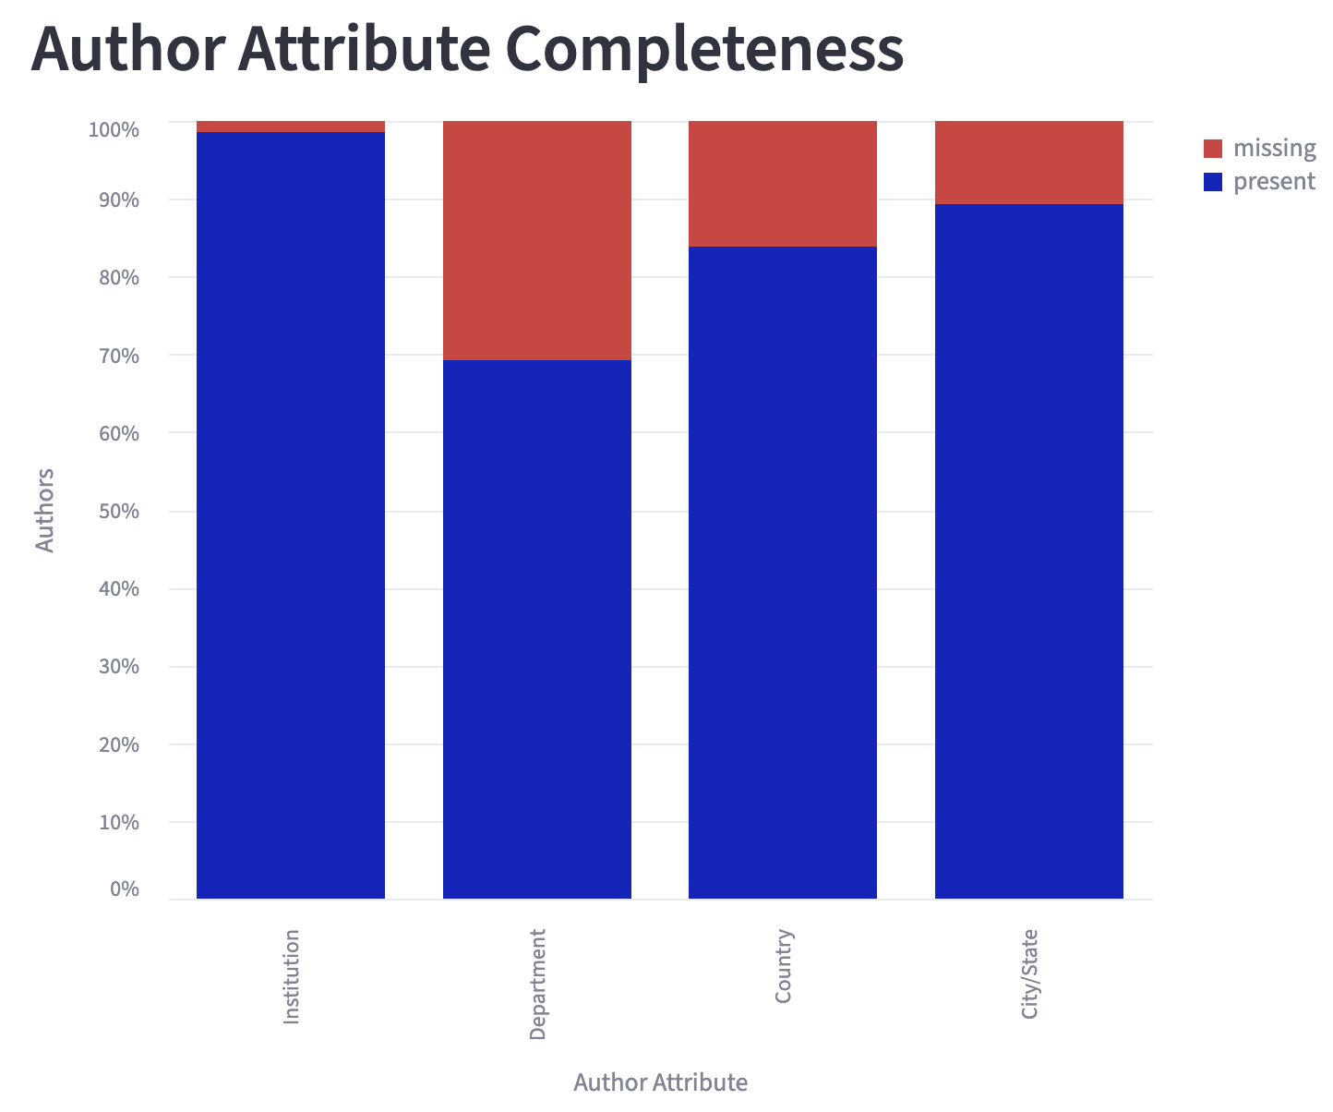
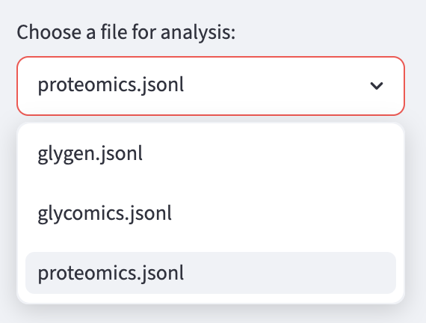
Project overview
Analyze a research domain using PudMed data
Query PubMed database for articles relevant to a given search term
Analyze article results

Slide 4
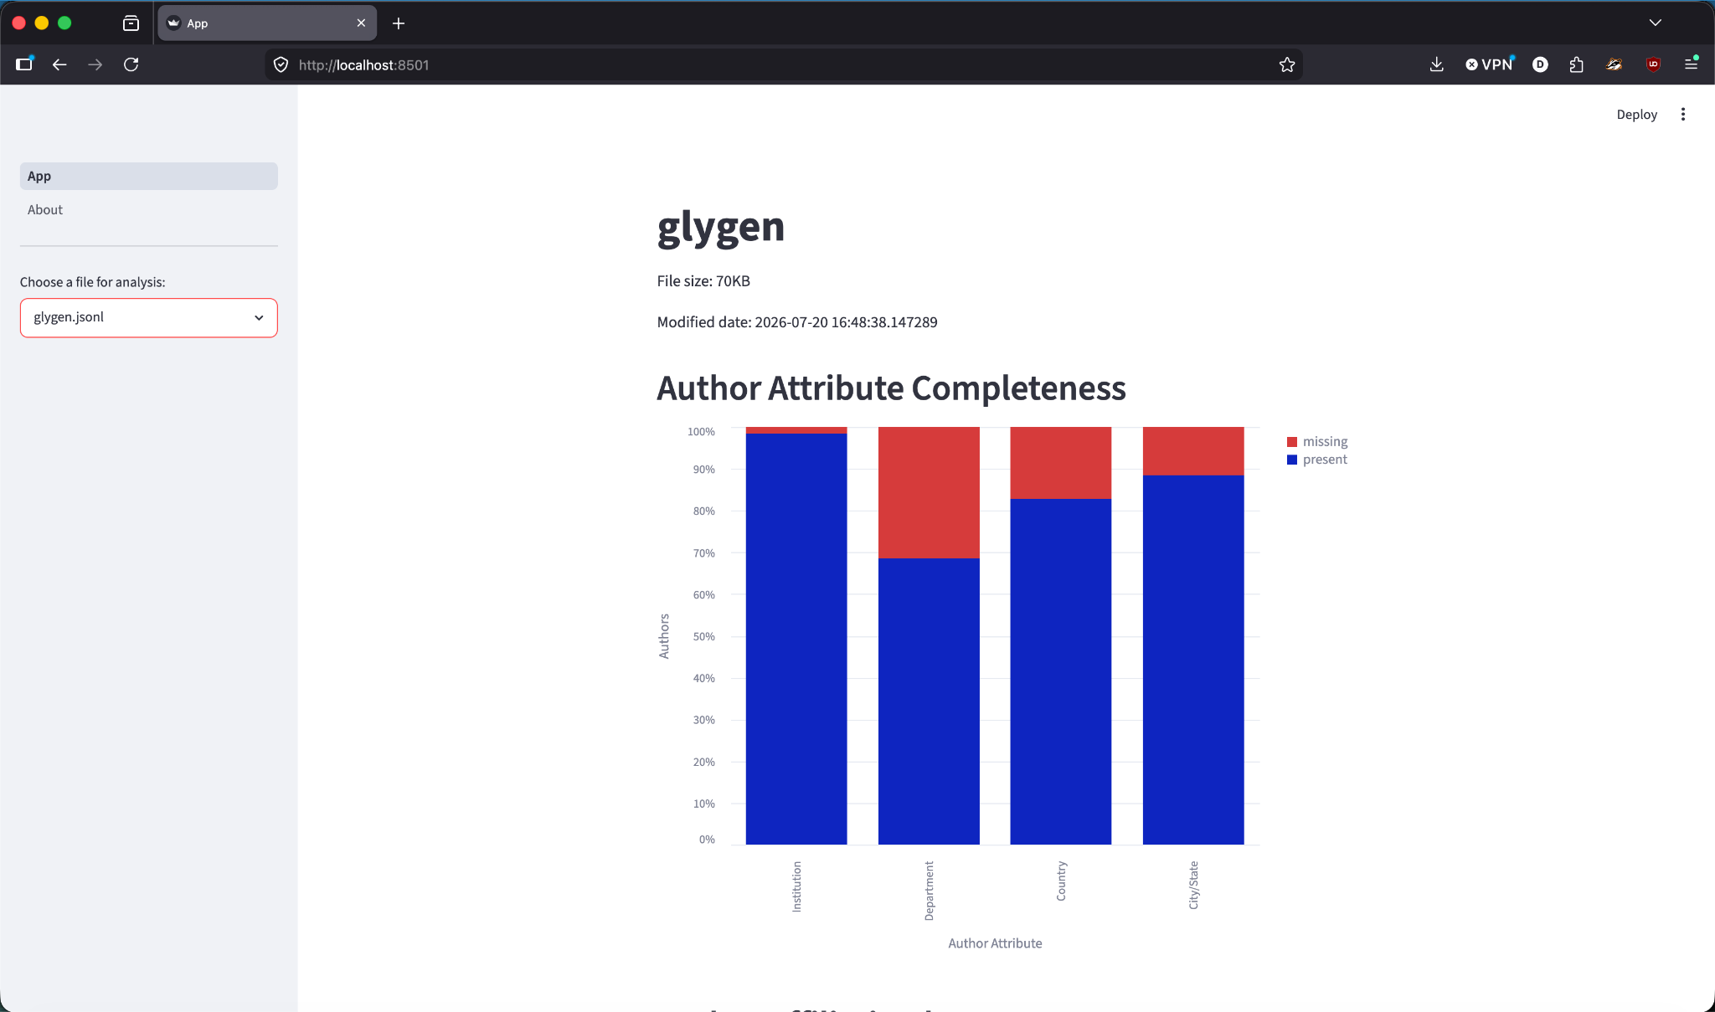

Workflow
Code can be found at https://github.com/glygener/pubmed-analyzer
List of Keywords
Docker Container
EDirect
Tools Script
Python Analysis Modules
Streamlit App
<XML/>
Keyword search
List of PMID
List of PMID
XML
Python
Parsing
{JSON}
Streamlit Dashboard

Slide 5
PubMed XML to JSON
PMID
Title
Publication year, month*
Journal
List of Authors
  Name
  Affiliation*
    Unit/Department*
    Institution*
    City*
    Country*
List of Keywords (MeSH terms)*
{
"pmid": "42172902",
"title": "Systems biology-driven analysis of obesity-associated genes with transcript mapping and post-translational modification annotations.",
"pub_year": 2026,
"pub_month": "Aug",
"journal": "Biochemical and biophysical research communications",
"authors": [
{
"name": "Sudeepti Kulshrestha",
"affiliation_text": "Informatics and Data Centre, Indian Council of Medical Research (ICMR) Headquarters, New Delhi, India.",
"department": null,
"institution": "Indian Council of Medical Research (ICMR)",
"city": "New Delhi",
"state": "New Delhi",
"country": "IND",
},
{
"name": "Priyanka Narad",
"affiliation_text": "Division of Development Research, Indian Council of Medical Research (ICMR) Headquarters, New Delhi, India. Electronic address: pnarad.hq@icmr.gov.in.",
"department": "Division of Development Research",
"institution": "Indian Council of Medical Research (ICMR)",
"city": "New Delhi",
"state": "New Delhi",
"country": "IND",
},
],
"mesh_terms": [
{
"term": "Protein Processing, Post-Translational",
"ui": "D011499",
"major_topic": true,
},
{"term": "Humans", "ui": "D006801", "major_topic": false},
{
"term": "Polymorphism, Single Nucleotide",
"ui": "D020641",
"major_topic": false,
},
{"term": "Systems Biology", "ui": "D049490", "major_topic": true},
{
"term": "Molecular Sequence Annotation",
"ui": "D058977",
"major_topic": false,
},
{"term": "Obesity", "ui": "D009765", "major_topic": true},
{"term": "Mutation", "ui": "D009154", "major_topic": false},
{
"term": "Genetic Predisposition to Disease",
"ui": "D020022",
"major_topic": false,
},
],
}
* sometimes

Slide 6
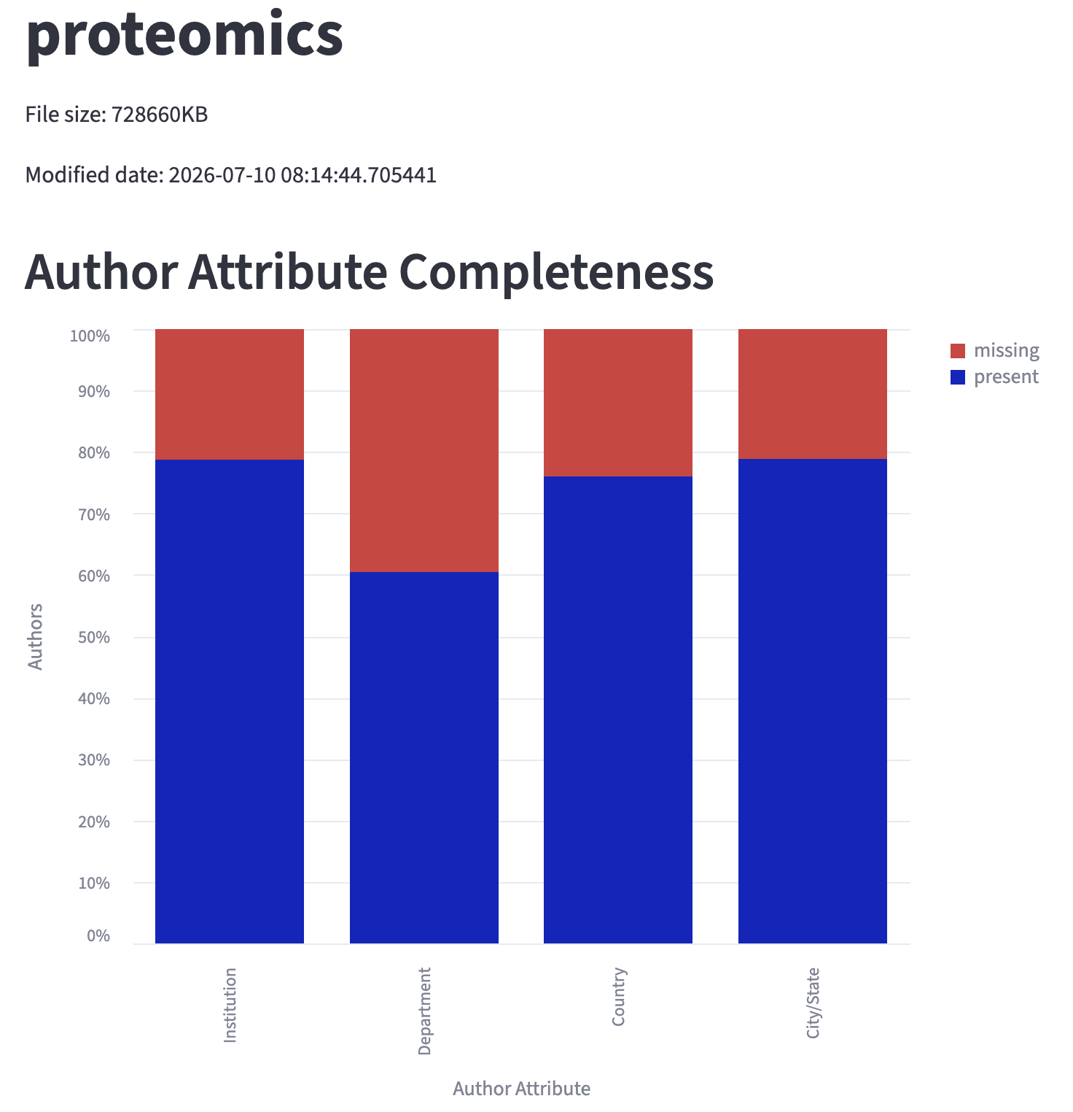
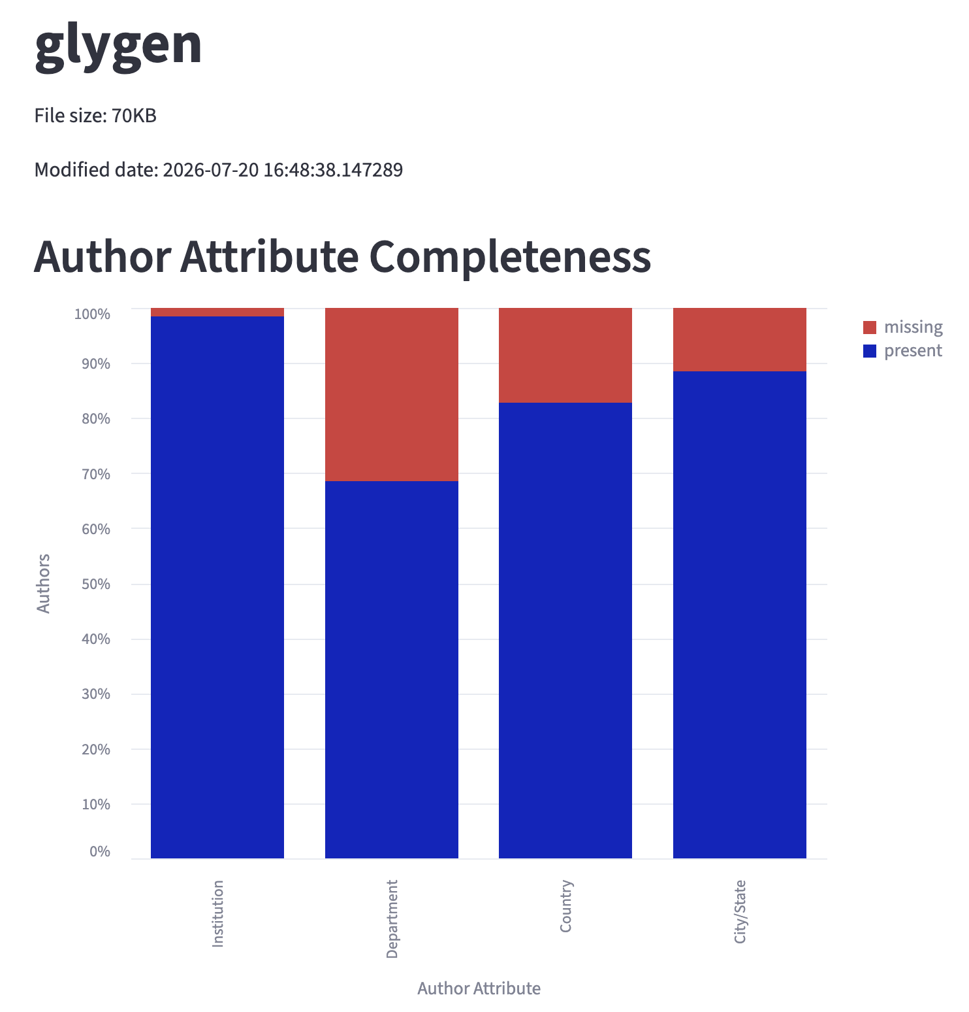
Analysis Modules
Author Attribute Completeness

Slide 7
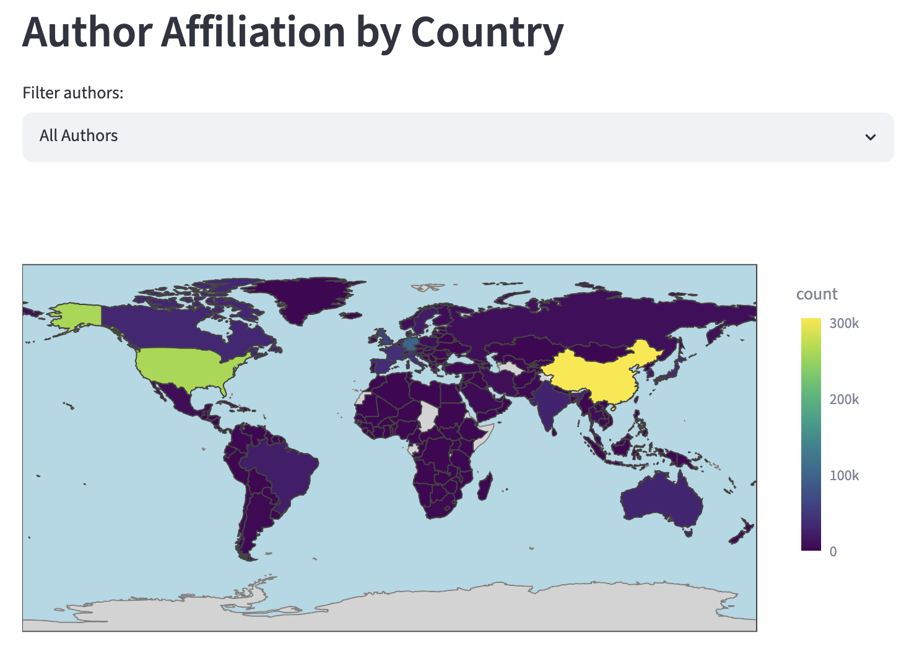
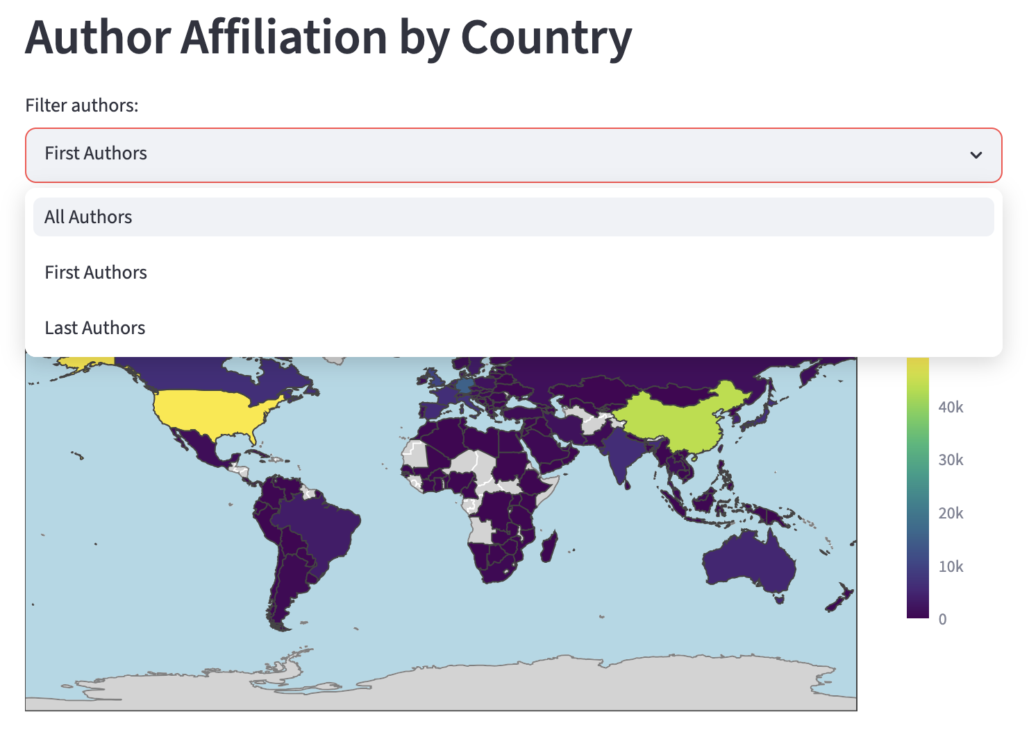
Analysis Modules
Geographical Analysis

Slide 8
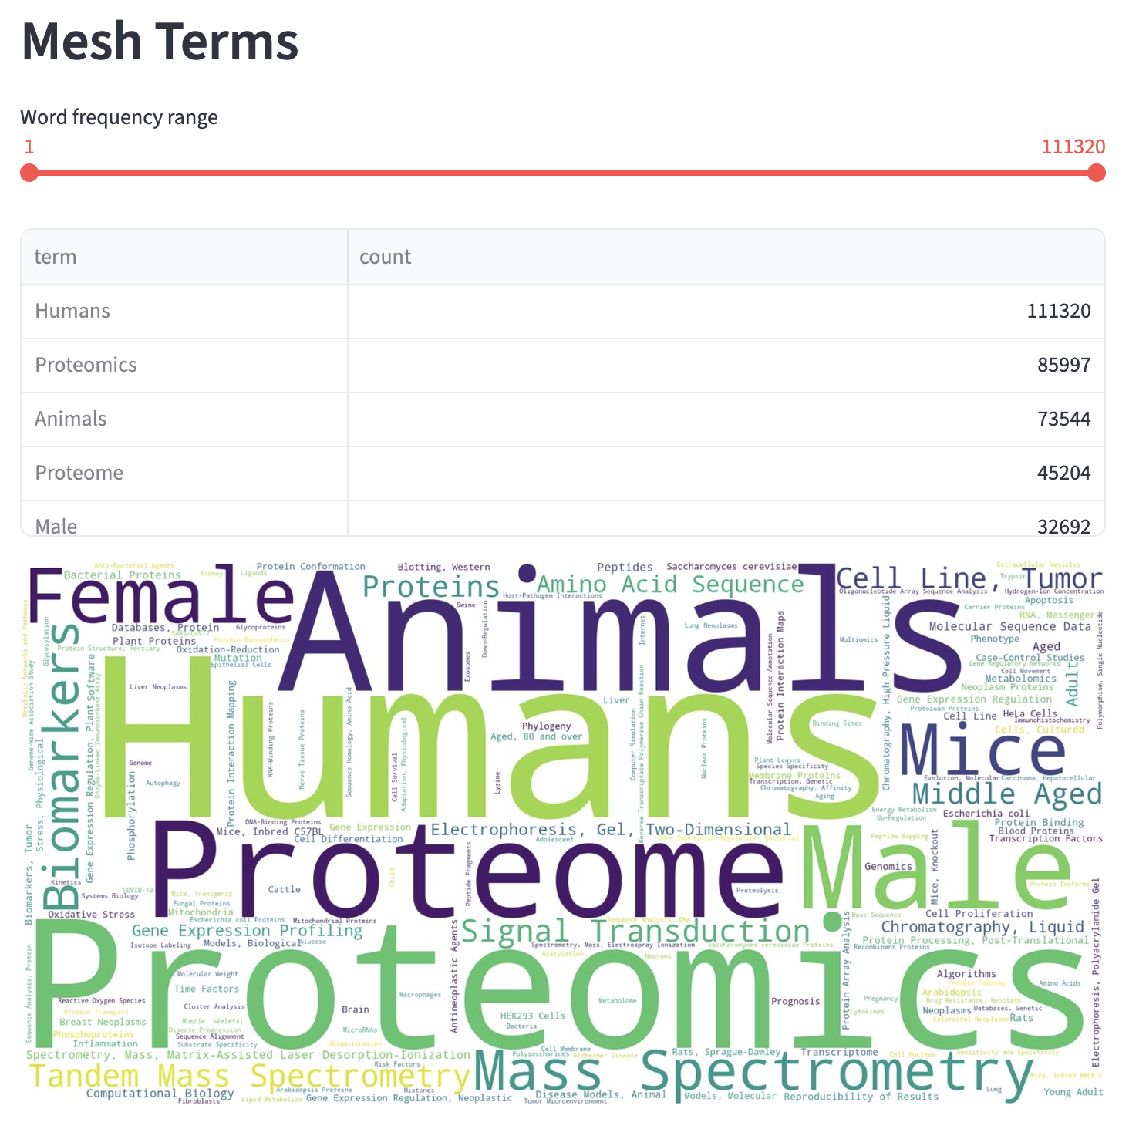
Analysis Modules
Mesh Term Word Cloud

Slide 9
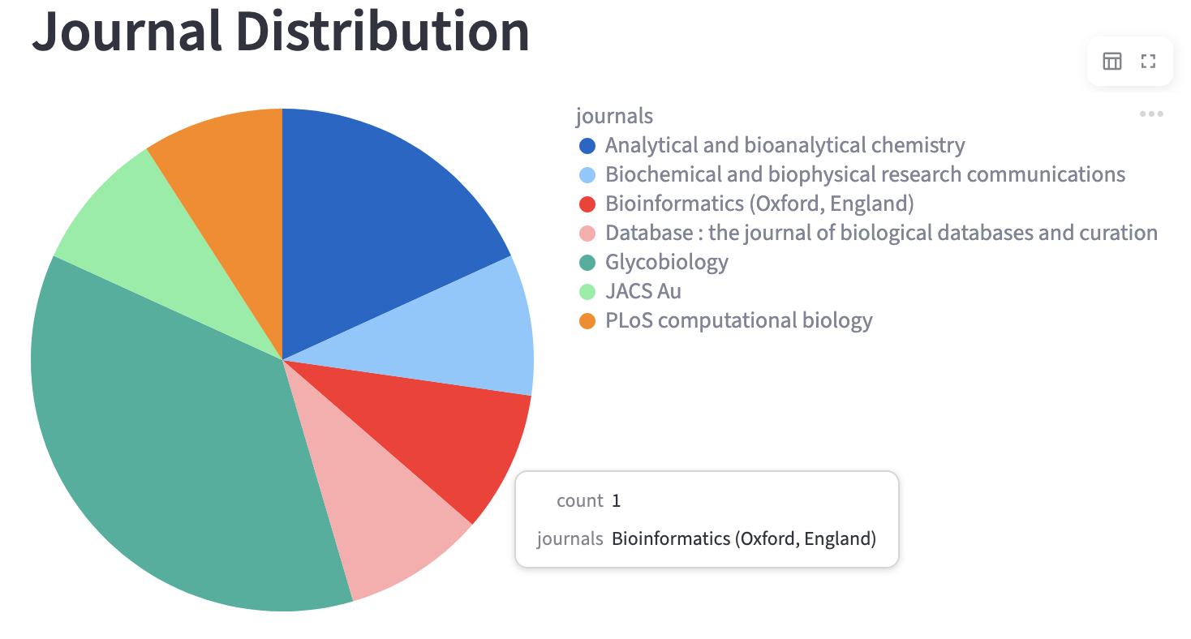
Analysis Modules
Journal Distribution Chart
Notes:
Show full journal names

Slide 10
Challenges
Inconsistent affiliation strings
Using GLiNER Python package to extract affiliation data using a Named Entity Recognition (NER) machine learning model
Potential file size limitations
{
"name": "Raja Mazumder",
"affiliation_text": "Biochemistry and Molecular Medicine; George Washington University, McCormick Genomic and Proteomic Center.",
"department": "Biochemistry and Molecular Medicine",
"institution": "McCormick Genomic and Proteomic Center",
"city": null,
"state": null,
"country": null,
}
{
"name": "Rene Ranzinger",
"affiliation_text": "University of Georgia, Complex Carbohydrate Research Center.",
"department": null,
"institution": "University of Georgia",
"city": null,
"state": "Georgia",
"country": null,
}

Slide 11
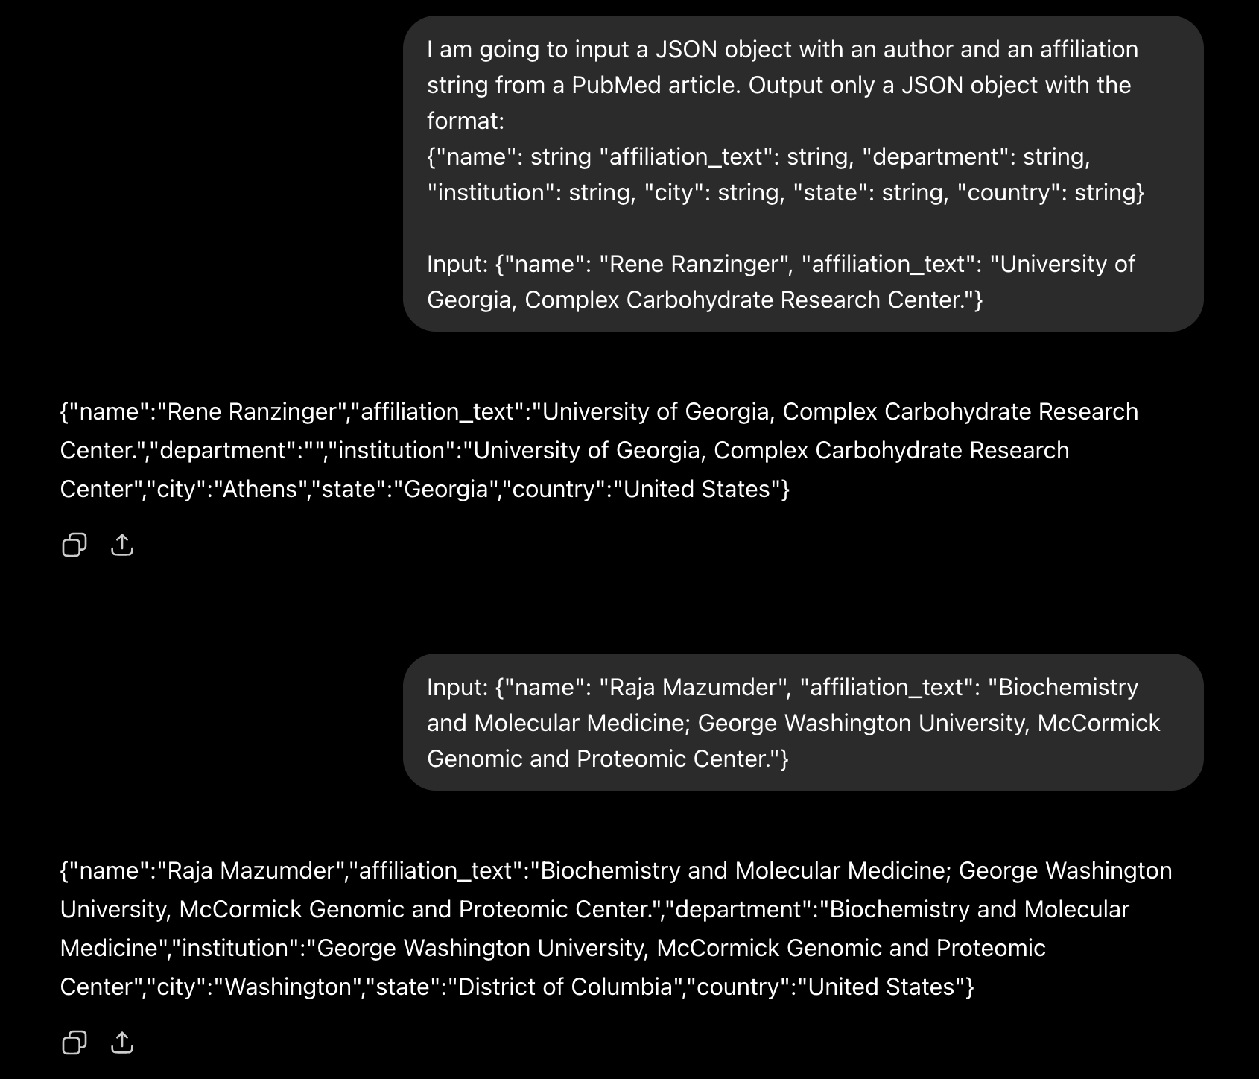
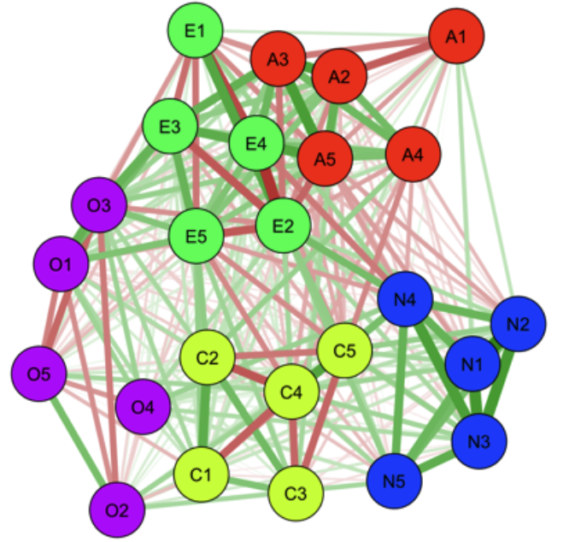
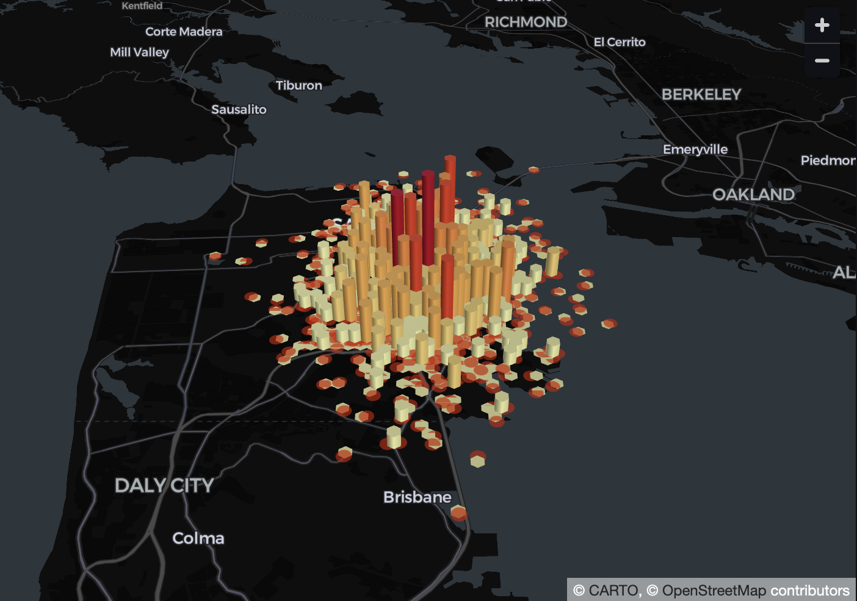
Future Considerations
LLM use case for affiliation string parsing
Further data parsing
More analysis modules
  SVG word cloud component
  Collaboration graphs
  More interactive elements

Slide 12
Acknowledgements
Special thanks to…
Rene Ranzinger
Sena Arpinar
Urnisha Bhuiyan
Raja Mazumder
Notes:
Add GWU and UGA logos

Slide 13
Questions

